Slide 1
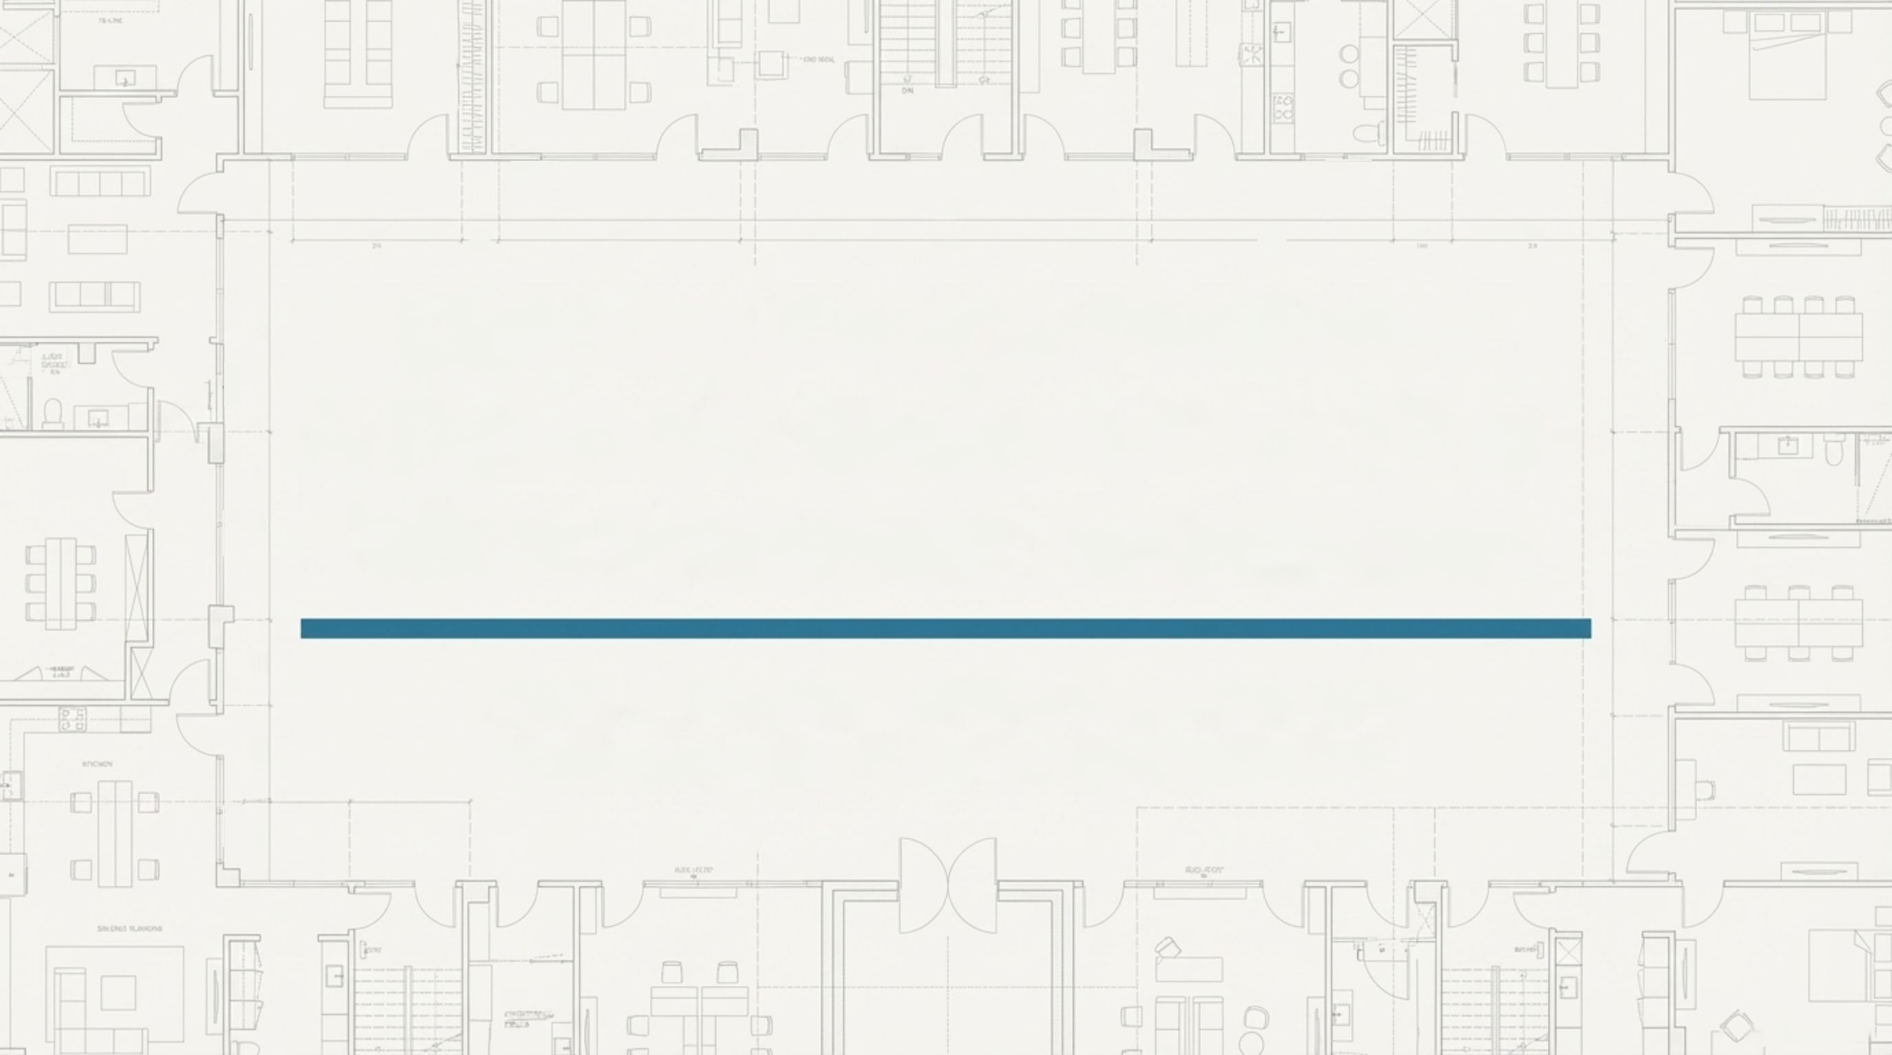











100
D6a7
2,.00
d.21
TDC
TROY
1G
DHE IOT
Lighting Design Platform
n00.1t51
I52
A Strategic Blueprint for Firm-Wide Workflow Automation
211
220'
NotebookLM

Slide 2


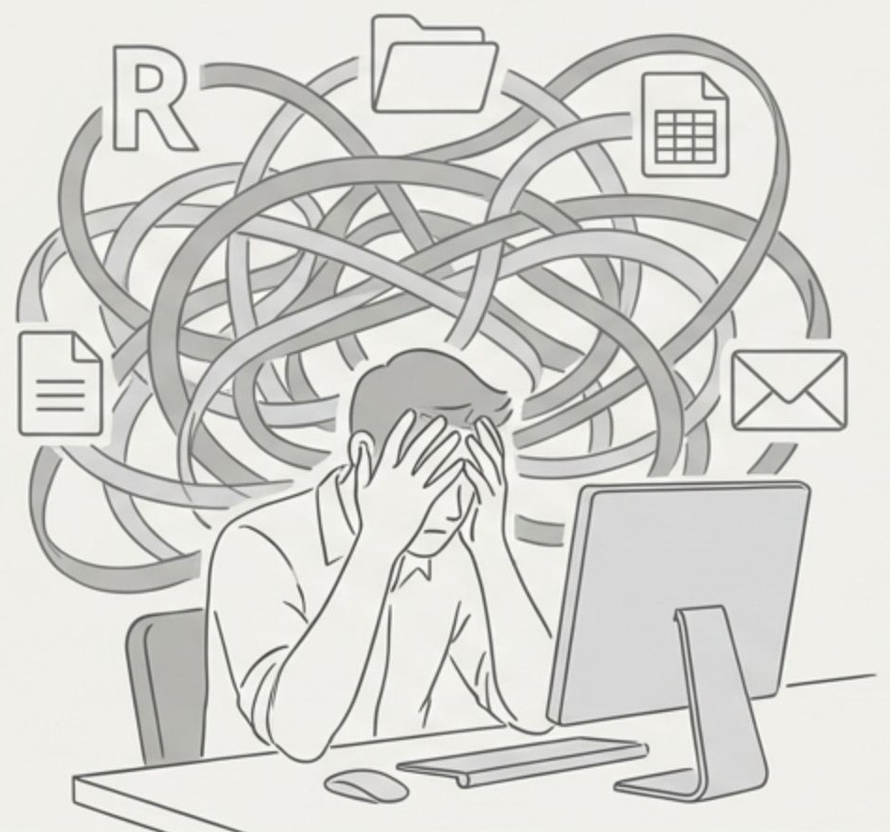




Our Current Lighting Workflow is Fragmented,
Consuming High-Value Time on Low-Value Tasks
Takeaway:
Designers are drowning in manual coordination across disconnected data sources, leading
to slow response times and costly rework.
Disconnected Data:
Project information is
scattered across network shares, Newforma,
SharePoint, PDFs, Revit models, and
spreadsheets, leading to version control issues.
Manual Documentation:
Designers spend an
estimated
96 hours per project
on non-
design tasks like creating schedules, formatting
deliverables, and manual QA/QC.
Slow Response to Change:
Late design
changes—a market reality—require a full manual
regeneration of deliverables, a process that takes
days and introduces risk.
NotebookLM

Slide 3
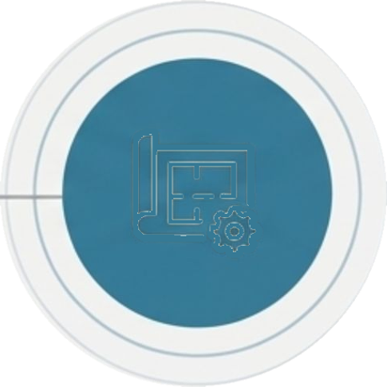




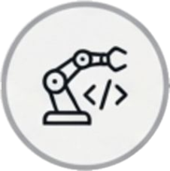
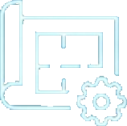

Al's Role is Shifting from Assistant to
Embedded Workflow Engine
Takeaway:
The competitive advantage is moving to custom, agent-like tools. Our opportunity is to build
a platform that harnesses this shift, starting with lighting—a high-value, well-understood workflow.
2012
2016
2020
2022
2024-2025 Agentic
Coding Tools ("Al
software engineers")
2026
Automation and Agents
for AEC Disciplines
Deep Learning
Foundations
Deep
Reinforcement
Learning
GPT-3 & LLMs
First Mass-Market
LLM Moment
(ChatGPT)
NotebookLM

Slide 4
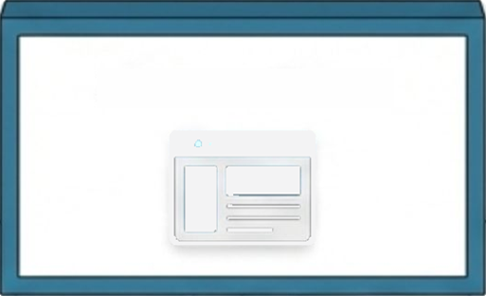
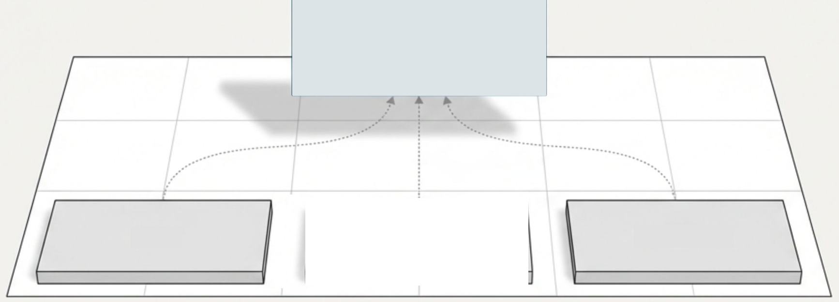





Our Solution: Centralize the Experience, Not the Data
LDP Web Portal
Connects to existing
file locations
Revit
SharePoint/
Newforma
Network Drives
Standardize Centralize
Automate
Amplify
LDP is a designer-facing web platform that provides a single, organized workspace. It connects to existing project
file locations, adding targeted tools for automation and analysis while avoiding a heavy, risky data migration.
NotebookLM

Slide 5

















A Smarter Architecture: Lightweight & On-Demand
Takeaway: Our modern approach respects our existing infrastructure and avoids risky,
always-on data pipelines.
Scoped, On-Demand Revit Connector:
All
Existing
Infrastructure
operations, especially writes back to Revit,
are explicit and logged.
Lighting Tool Suite
(Phase 1)
LDP Platform
Revit
Web App Shell
(Frontend)
Schedule Builder
SharePoint
File Access &
On-Demand
Indexing Layer
QA/QC Assistant
Network Shares
On-Demand Indexing:
Extracts minimal
metadata *only* when a tool is run.
NotebookLM

Slide 6
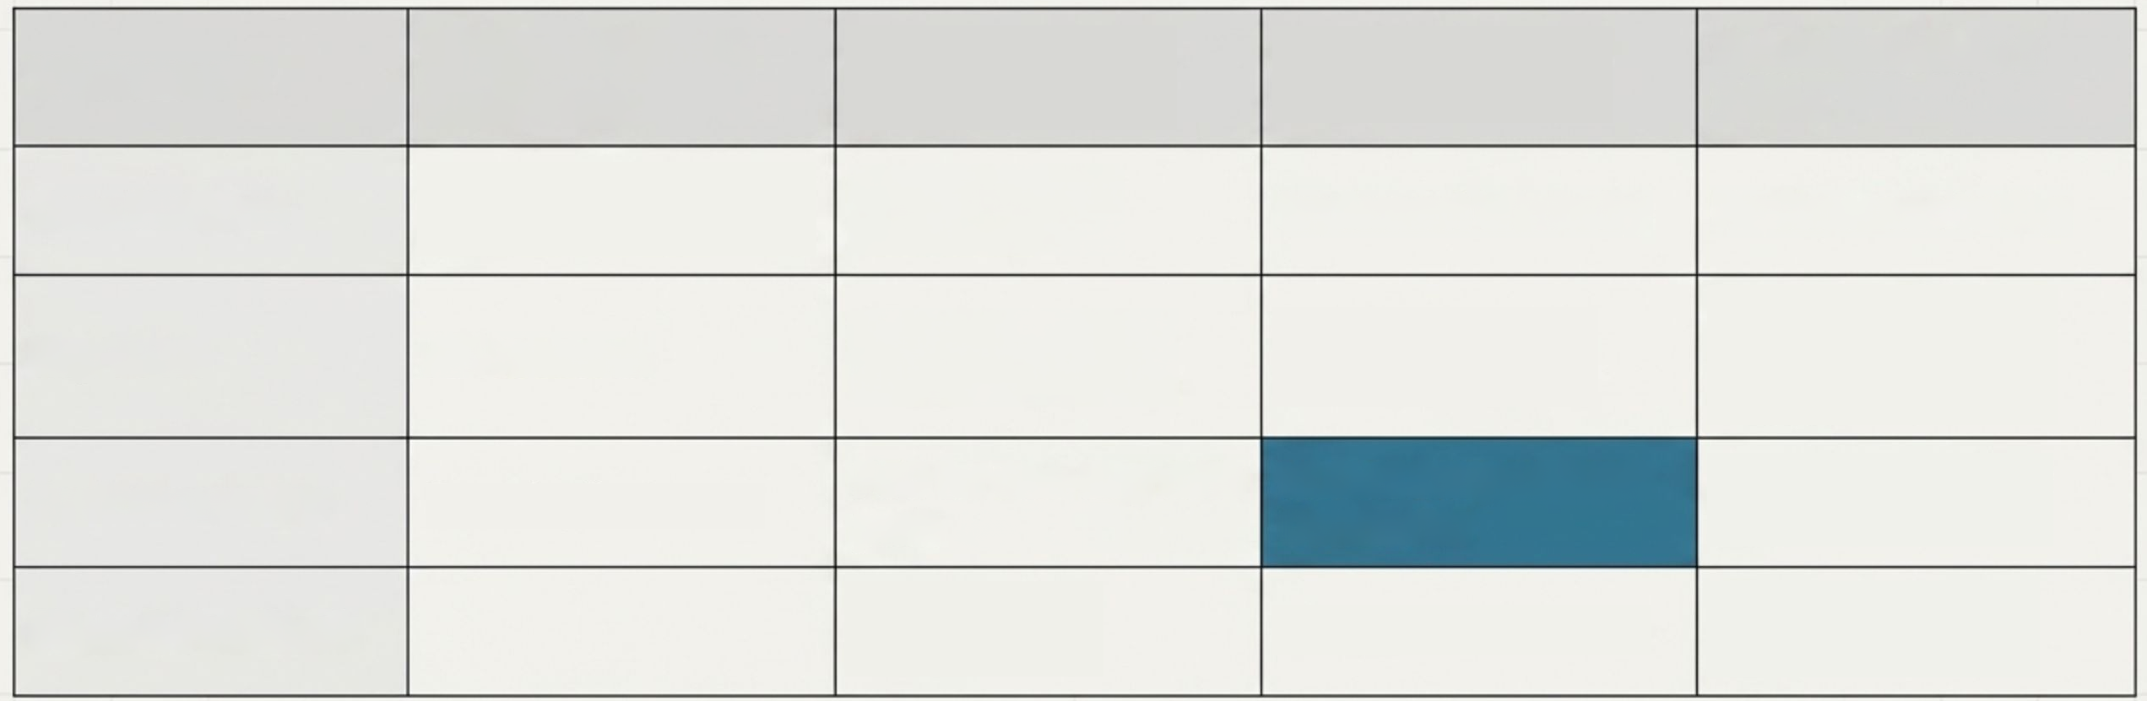

Our 2026 Roadmap Delivers Incremental
Value Each Quarter
Takeaway:
Our plan de-risks the project by focusing on foundational work first, followed by
phased tool releases and pilot feedback loops.
Workstream
Q1: Foundation &
Discovery
Q2: Core Tools &
Alpha
Q3: Integration
& Beta
Q4: Production
& Scale
Core Platform
Finalize tech stack,
Schedule Builder PoC
Central project
dashboard
Implement telemetry
Performance tuning
Schedule Builder
(Alpha) for testing
Schedule Builder
(Beta) on 1st pilot
Schedule Builder &
QA/QC tools v1.0
release
Key Tools
API research
Revit Connector
Recruit pilot teams
PoC for one-way
data push
v1.0 of Scoped Revit
Connector
Bi-directional sync
PoC
Pilots & Feedback
Internal Alpha
Launch
Internal Beta Launch
Gather formal
ROI data
NotebookLM

Slide 7








By the End of 2026, We Will Deliver a Platform Proven
to Save Time and Improve Quality
Takeaway: Success is defined by six measurable outcomes spanning platform adoption, tool efficiency, user
satisfaction, and strategic readiness.
Platform Adoption
Schedule Builder Efficiency
Validated ROI
LDP is the standard starting point for
schedule creation on all new lighting
projects by Q4.
The tool is used on at least 15 projects
and reduces schedule creation time by
over 40% on pilots.
A formal report based on data from 5+
pilot projects validates the core time-
saving assumptions of our ROl model.
Positive User Feedback
Expansion Blueprint
Revit Sync Deployed
An EOY survey shows >80% of pilot
users agree/strongly agree that LDP
improves their workflow efficiency.
A documented playbook for adapting the
LDP architecture for another discipline
(e.g., MEP) is finalized for a Q1 2027 pilot
proposal.
The v1 Scoped Revit Connector is used
on 5+ pilot projects, reducing manual
data re-entry errors by over 90%.
NotebookLM

Slide 8





We Can Tailor Our 2026 Investment to Match Our Ambition
Takeaway: The choice between scenarios is a direct trade-off between upfront investment and the speed at which we
validate the platform and realize its ROl.
Minimal/Pilot
Baseline/Recommended
Expanded
/Aggressive
What Gets Built:
Core portal +
What Gets Built:
Robust platform +
What Gets Built:
Full Phase 1 MVP
Schedule Builder MVP. Revit sync
PoC only.
Schedule Builder & QA/QC v1.
Scoped Revit Connector for pilots.
(multiple tools). Bi-directional Revit
sync in production.
2026 Rollout:
Single champion
2026 Rollout:
1-2 key office
2026 Rollout:
Firm-wide rollout to
team on 2-3 projects.
locations on 5-10 projects. Formal
training launched.
all lighting designers.
Tradeoffs:
Lower cost, but slower
Tradeoffs:
Fastest path to impact
validation and ROl. High risk of
losing momentum.
Tradeoffs:
Balanced investment.
and full ROl. Higher upfront cost and
change management effort.
Proves value and ROl within 2027.
Strong foundation for expansion.
Est. 2026 Cost:
Est. 2026 Cost:
Est. 2026 Cost:
~$90,000
~$175,000
~$350,000
NotebookLM

Slide 9




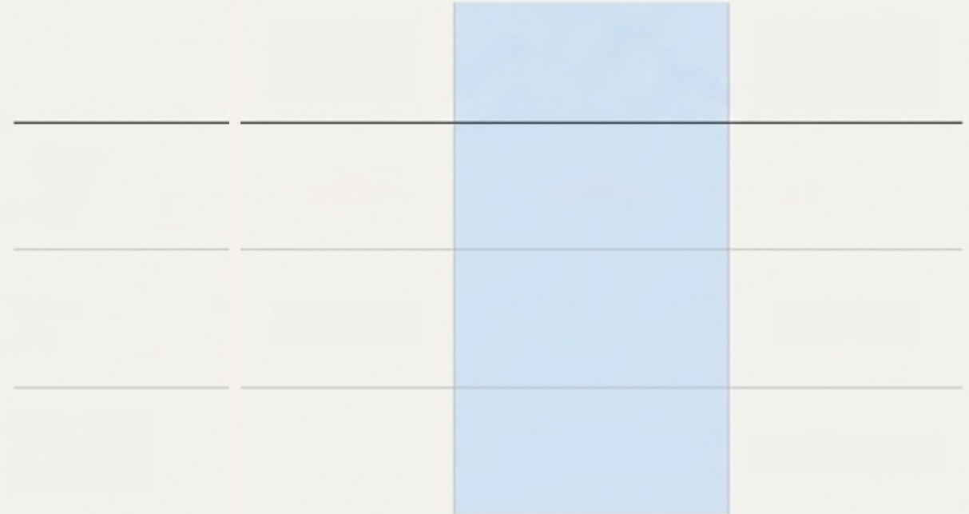

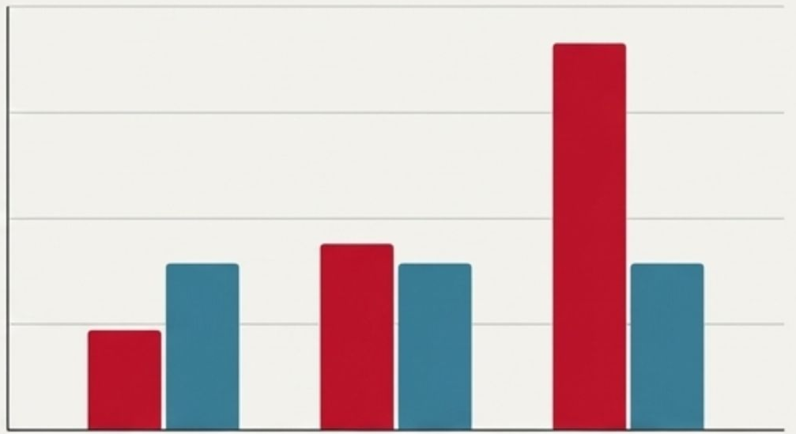

A Platform That Pays for Itself
Takeaway: All scenarios deliver a strong ROl, with the Baseline investment paying for itself in ~13
months while freeing up thousands of hours for higher-value design work.
ROl & Payback Period
Investment vs. Annual Value Creation
2026 Investment
Annual Value Creation
Minimal/
Pilot
Baseline/
Recommende
d
Expanded/
Aggressive
400,000
2026
Investment
300,000
~$95k
~$175k
~$365k
Dollars($)
200,000
Annual Value
Creation*
$157,440
$157,440
$157,440
100,000
Payback
Period
~8 Months
~13 Months
~28 Months
0
Minimal
Baseline
Expanded
*Annual value based on conservative estimates of time saved. Payback period begins after full rollout and adoption.
NotebookLM

Slide 10
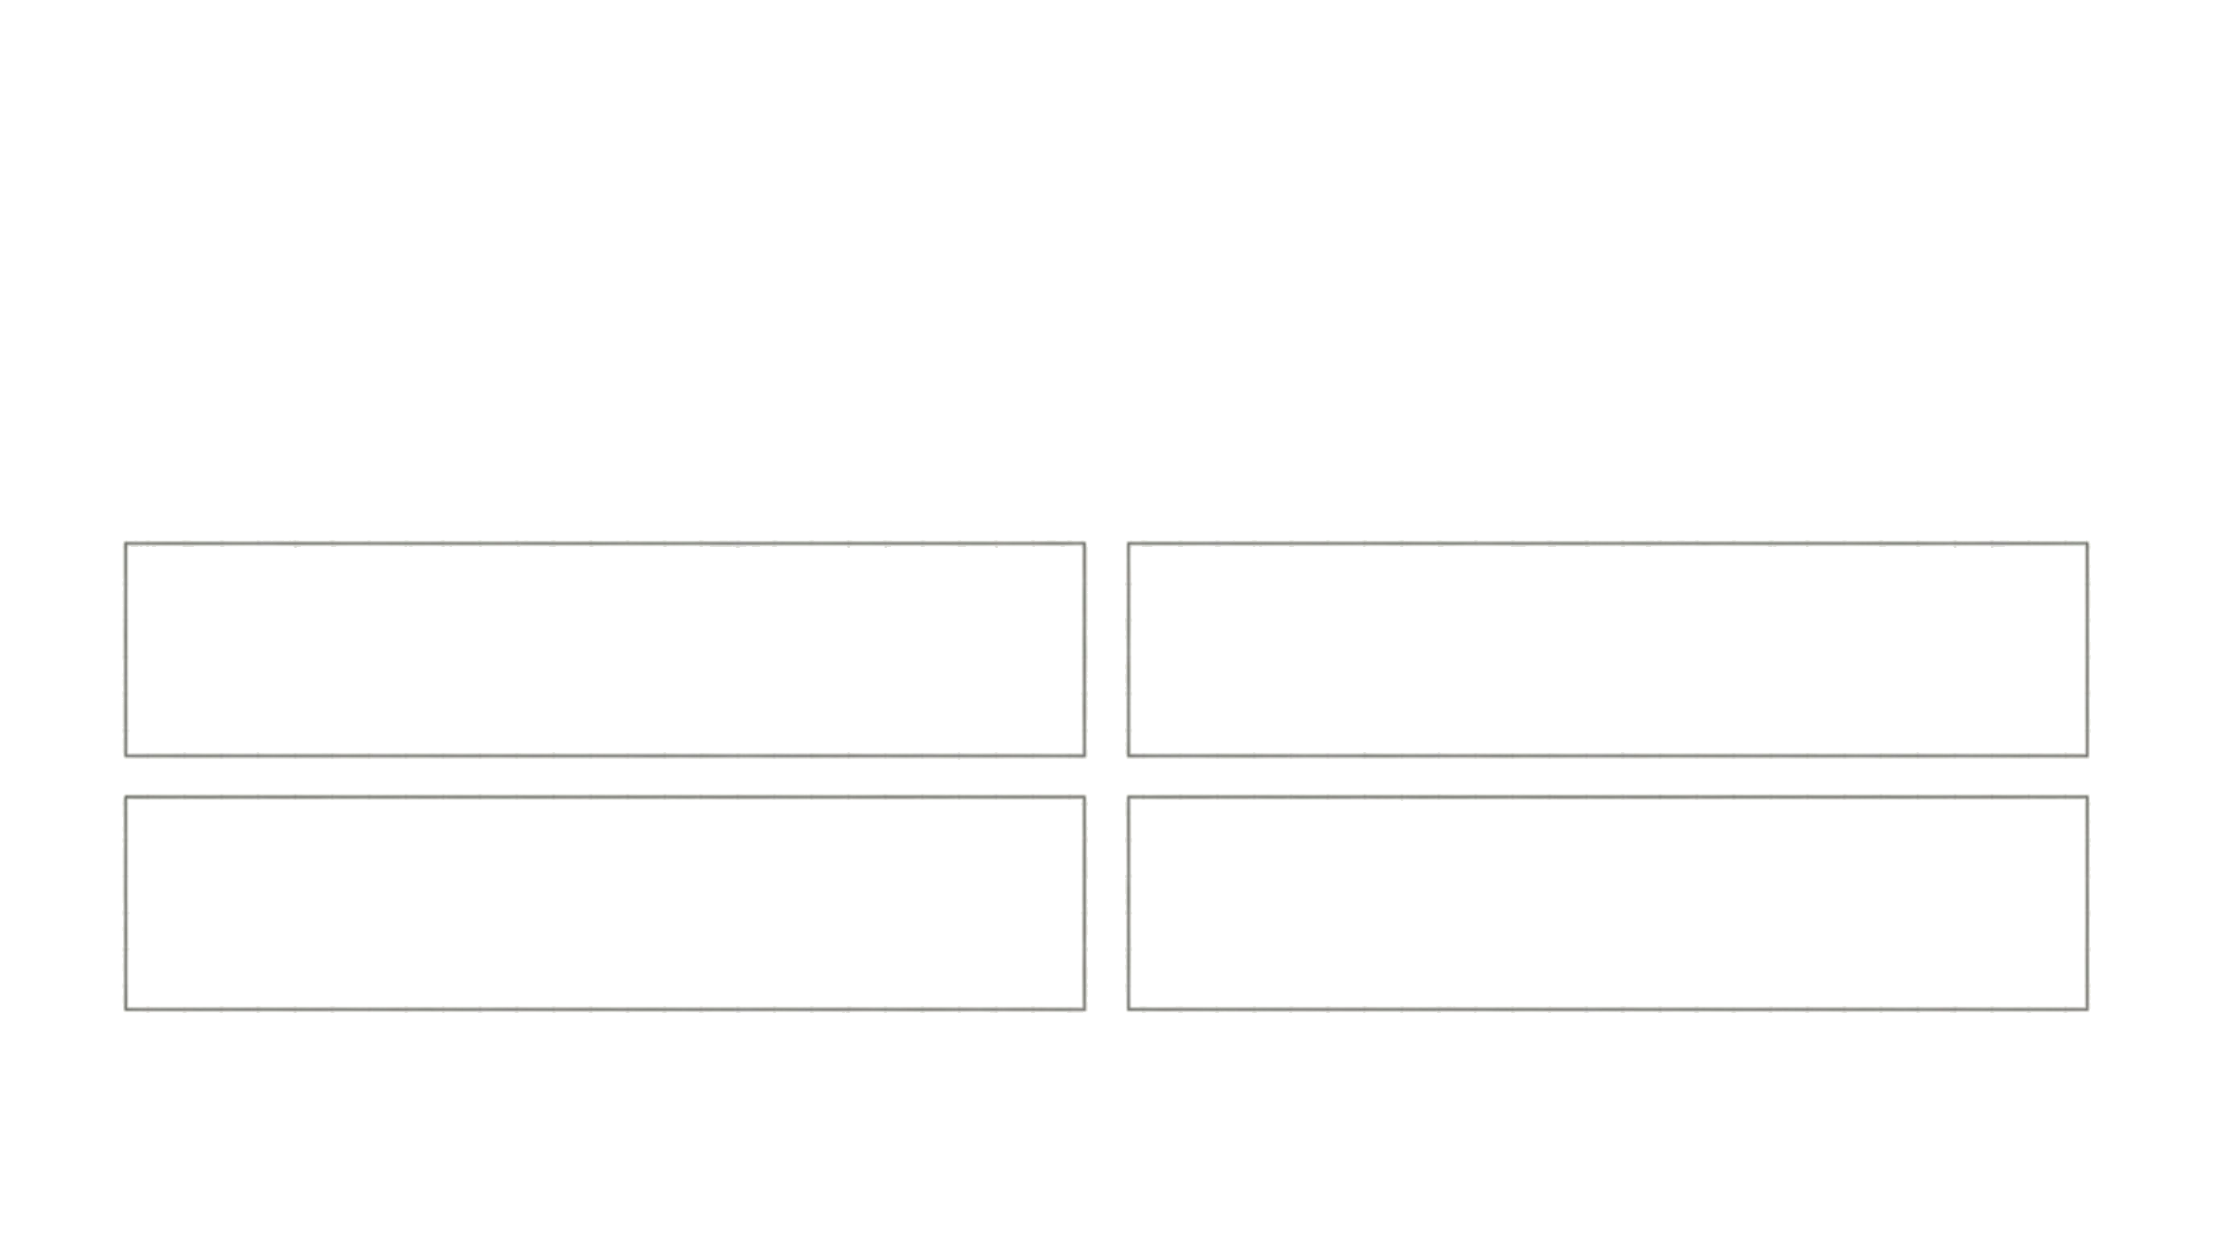





The Real Value: Unlocking Higher-Quality Design
Takeaway: By increasing the efficiency of documentation,we don't just save time; weunlock
latent demand for better design.This istheJevons Paradox in action.
These "saved" hours are not a cost cut; they are hours reinvested into higher-value activities
that clientswantbut wecurrently lack time for:
More Design Options Studied
More Thorough QA/QC
More Sophisticated
Deliverables
More Lighting Design Services
LDP positionsthe firm to capture thislatent demand rather than letting it go unmet.
NotebookLM

Slide 11


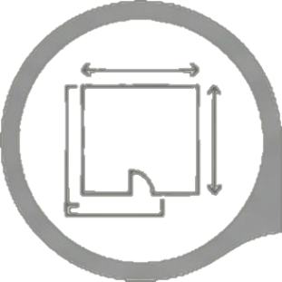
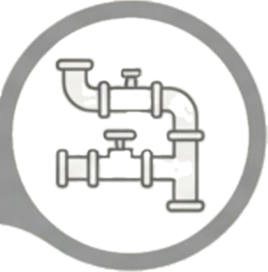
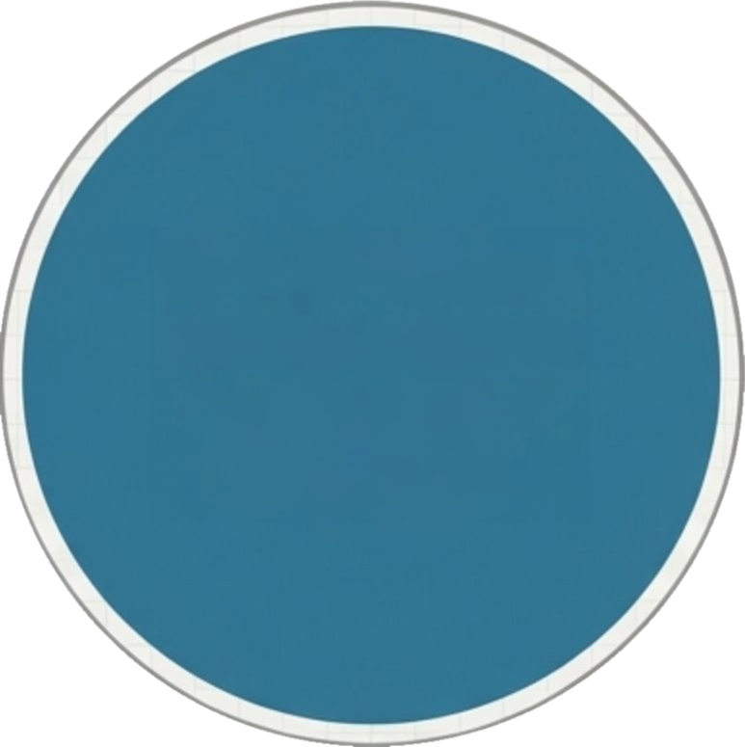



Beyond Lighting: A Blueprint for Firm-Wide Innovation
Takeaway: LDP is intentionally architected as a pattern that can be replicated forother disciplines with
fragmented workflows and clear automation opportunities.
Architecture/Interiors:
Room
LDP Blueprint:
Standardize >
Centralize
Automate
MEP:
Submittal ingestion,
data sheets, finish schedules,
code-check summaries.
parameter validators, schedule
generation.
Site/Civil:
Quantity
Structures:
Detail
Take-Off (QTO)
extraction, utility
coordination.
checks, calculation
package assembly,
shop-drawing diffing.
The technical pattern—-a lightweight portal with on-demand indexing and scoped connectors——is the key to scaling this success.
NotebookLM

Slide 12





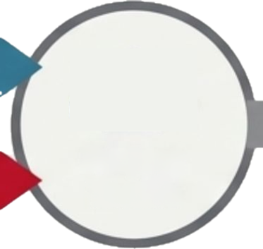








LDP and BiM Automation are the Two
Halves of a Complete Digital Delivery
Stack
Takeaway:Investing in both creates a virtuous cycle where a better model feeds a more efficient
workflow, which in turn provides better data back to themodel, creating multiplicative benefits.
Current BiM automation
initiativesare correctly
focused on improvingthe
model.
BIM Automation
(Documentation Process)
TheLDP is the
complementaryinnovation that
improves the surrounding
workflow,documentation, and
analysis that designeigners
still handle manually.
Project
Higher
Quality
Delivery
Teams
LDP Platform
(Design Process)
NotebookLM

Slide 13








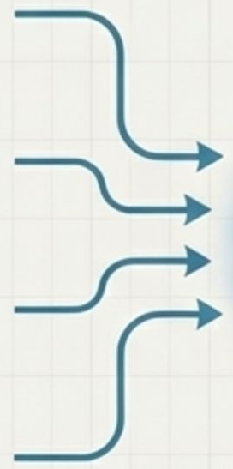












This Investment isthe First Step Toward the Future of AEC
Takeaway: Our goal is a firm-wide "Agentic AEC Platform" that leverages human-Alcollaboration to automate
documentation and unlock contextual intelligence. LDPis the prototype that proves this vision.
FUTURE OF AEC:MULTIMODAL AGENTIC DESIGN & DOCUMENTATION
MULTIMODAL INPUTS
(DESIGNERS & ENGINEERS)
AUTOMATED
DOCUMENTATION
& OUTPUTS
TEXT &
DESIGN MODELS
SPEECH
TRAINING
DATA
(BIM)
IMAGES &
DRAWINGS
SKETCHES
AGENTIC
AEC
PLATFORM
& SPECS
CONTEXTUAL
AWARENESS
AI AGENTS
VIDEO & 3D
SCHEDULES
CAPTURE
&COST
PDFs & PLAN
DRAWINGS
PERFORMANC
E ANALYSIS
HUMAN REVIEW
& FEEDBACK
ITERATIVE REFINEMENT
NotebookLM

Slide 14


Our Recommendation & Next Steps
Takeaway:
We recommend the
Baseline Investment of ~$175,000 for 2026.
To
proceed, we are seeking leadership's endorsement on three key points:
1.
Endorse the Architectural Posture
LDP as a lightweight portal with on-demand indexing and scoped Revit connectors,
explicitly avoiding a heavy, always-on data pipeline.
2.
Approve Phase 1 Scope & Resourcing
Invest in a focused team to deliver the project workspace, schedule builder MVP,
QA/QC tools, and one pilot Revit add-in.
3.
Recognize LDP as a Strategic Prototype
Treat this as the pilot for a broader, Al-enabled, discipline-centric tool strategy at
the firm.
NotebookLM

Slide 15













Appendix: 2026 Detailed Cost Breakdown(Baseline Scenario)
Takeaway: Our baseline investment of ~$175k is a transparent, targeted allocation towards core platform development
and successful pilot adoption. All figures are estimates.
Product & Engineering (Total: $102,000)
Lighting Tech Lead: 5 FTE-months @ $10,000/month = $50,000
Full-Stack Developer: 5 FTE-months @ $10,000/month = $50,000
API/ Library Licenses: Annual licenses = $2,000
Cloud Infrastructure & Tools (Total: $18,000)
Cloud Hosting (Azure/AwS):$1,000/month x 12= $12,000
Al Service APls (OpenAl/Gemini):$250/month x 12 = $3,000
CI/CD & Monitoring Tools: Annual cost = $3,000
Design/UX/Research (Total:$12,800)
UX/Ul Design: 80 hours @ $60/hour = $4,800
User Research & Testing: 4 sessions x 20 users x $100 incentive/hour = $8,000
Training & Change Management (Total: $5,900)
Documentation & Training Videos: 40 hours @ $60/hr = $2,400
Pilot Launch Workshops: Facilitation and materials = $3,500
Contingency (15%) (Total: ~$22,900)
Calculated as 15% of Subtotal ($151,500)= $22,725
Estimated 2026 Total (Baseline):
~$175,000
NotebookLM

